Slide 1
ETL Project Summary
Background: Summarize certain NBA players career performances.
Summary:
E (Extraction): 2 open sources,
www.kaggle.com
NBA-API
T (Transform): For each year, summarize the teams they used to play for, personal scores, FG%, FT%, assists and blocks.
L (Load): Define the schema then loaded into SQL database for easily control and readability.

Slide 2
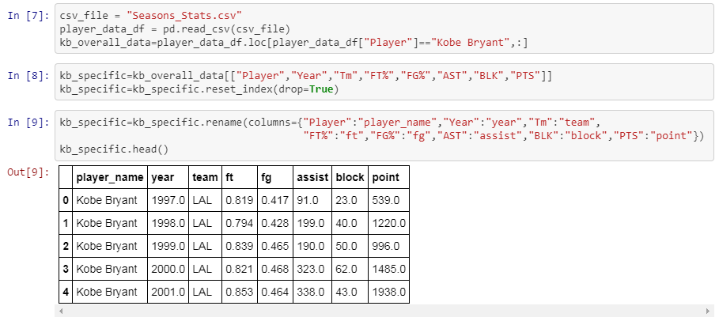
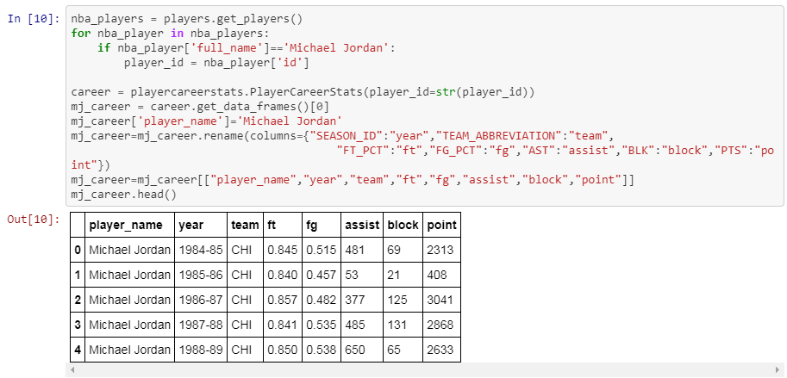
Extract and Transform
Get Kobe Bryant’s performance raw data from Kaggle.com while Michael Jordan’s performance raw data from NBA-API.
Reserve year, team, FT%, FG%, assist, block and points.
Kaggle.com
NBA API

Slide 3
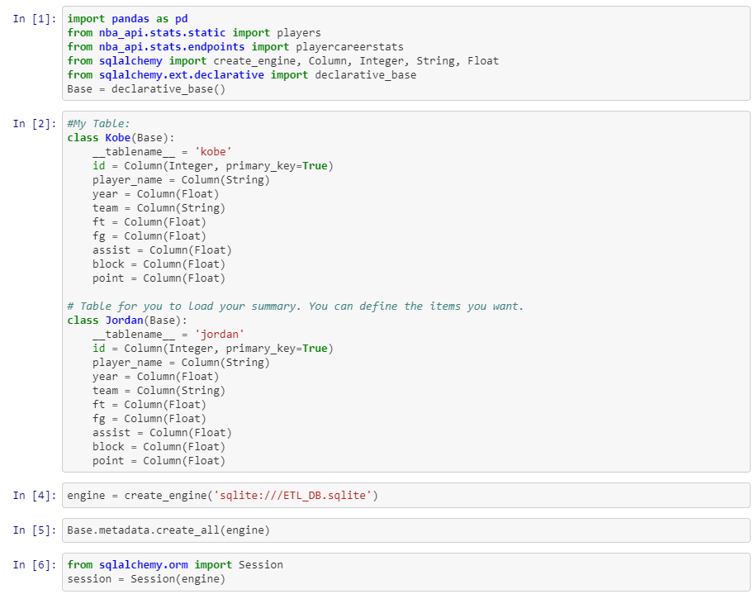
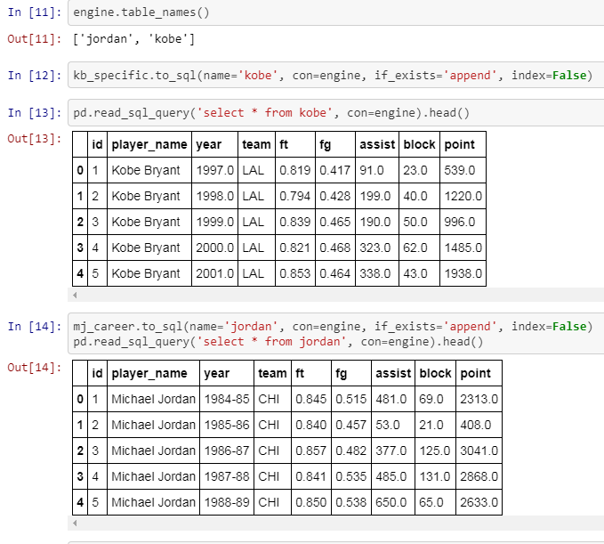
Load
Load into the SQL database and tables defined at first.
Read to confirm if loaded successfully.

